Slide 1
Pointing
Beam Shift Measurement

Slide 2
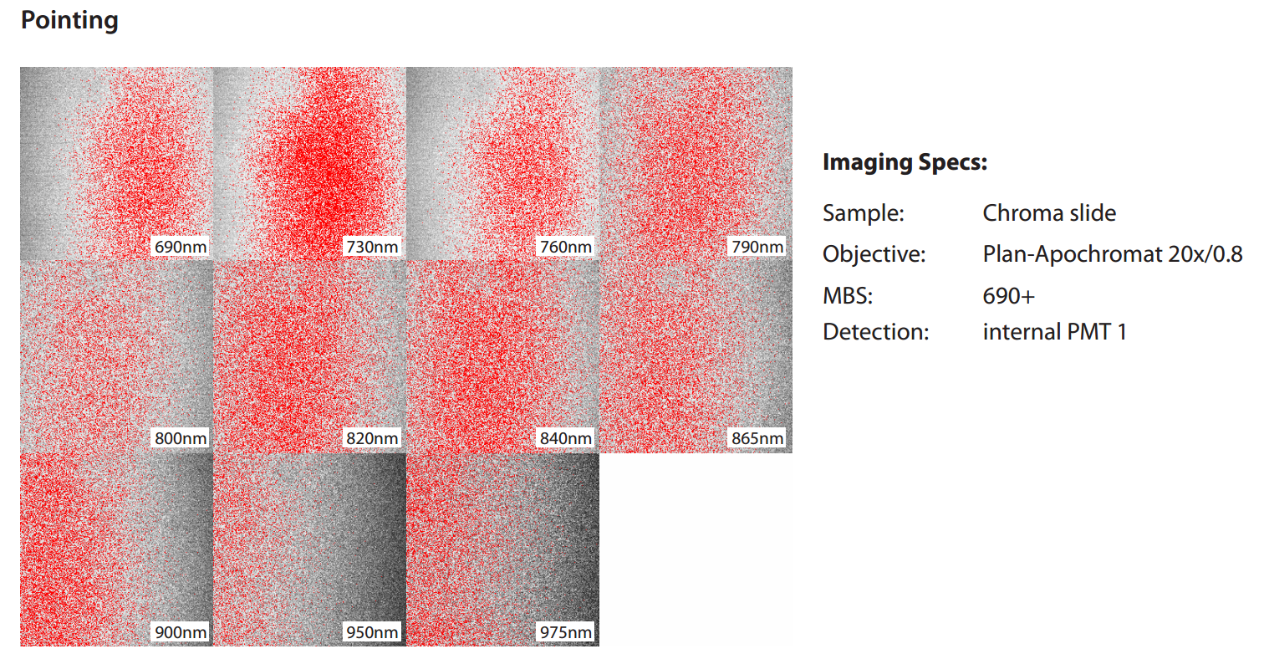
Customer’s Concern
Laser Beam drifts away from Target:

Slide 3
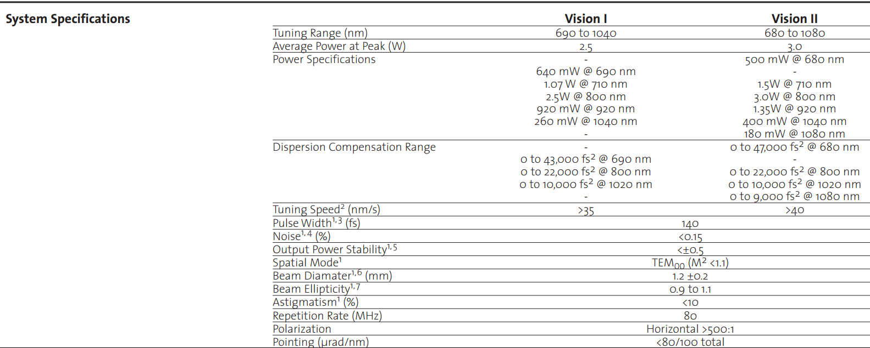
Chameleon Specification Part 1
Chameleon V2 has a potential to “Point away”, if GDD is slightly misaligned.

Slide 4
Pointing Measurement: Setup
Setup:
Place wedged beam-splitter in front of Chameleon head
You will have about 95% transmission and two reflecting beams.
Choose the front reflection for the measurement, and block the other one
Steer the beam with two HR mirrors i.e. in zig-zag across the available space on the table
Place the Thorlabs detector as far away as possible.
Glasgow factory recommends a distance of at least 3m.

Slide 5
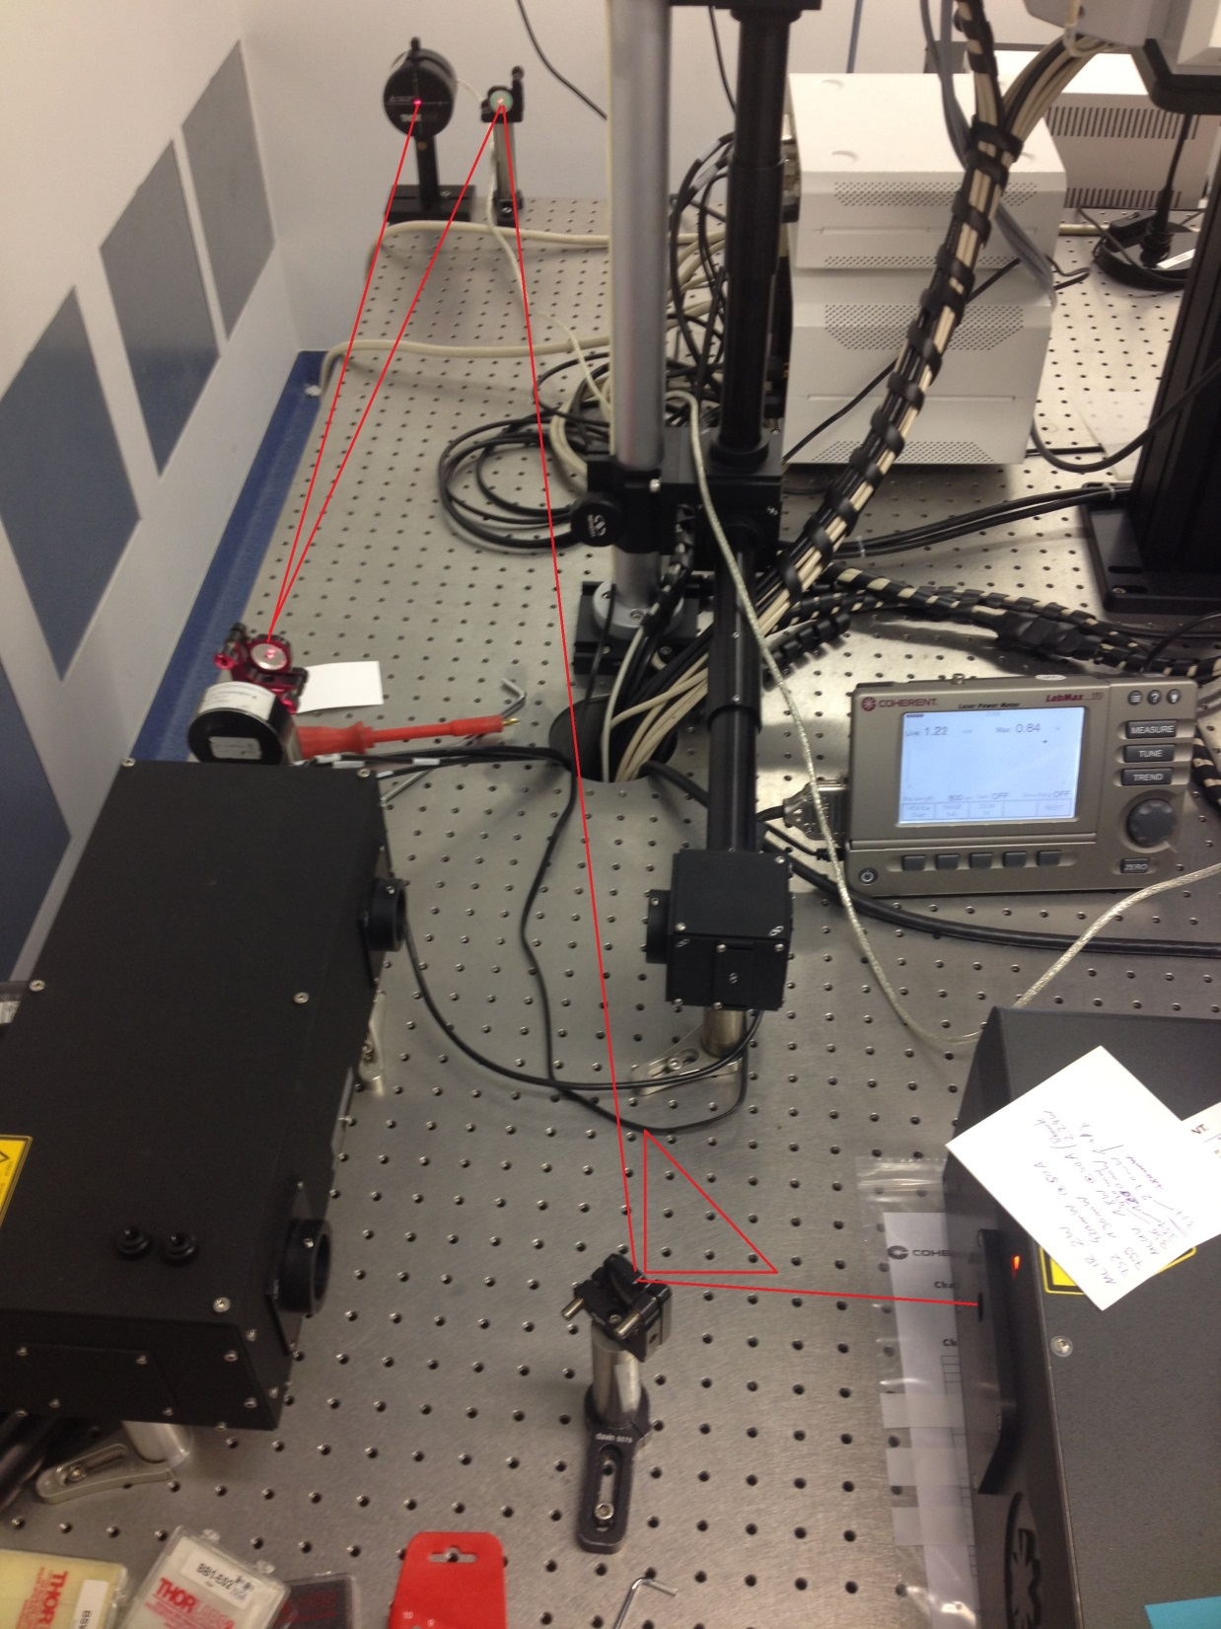
Pointing Measurement: Setup

Slide 6
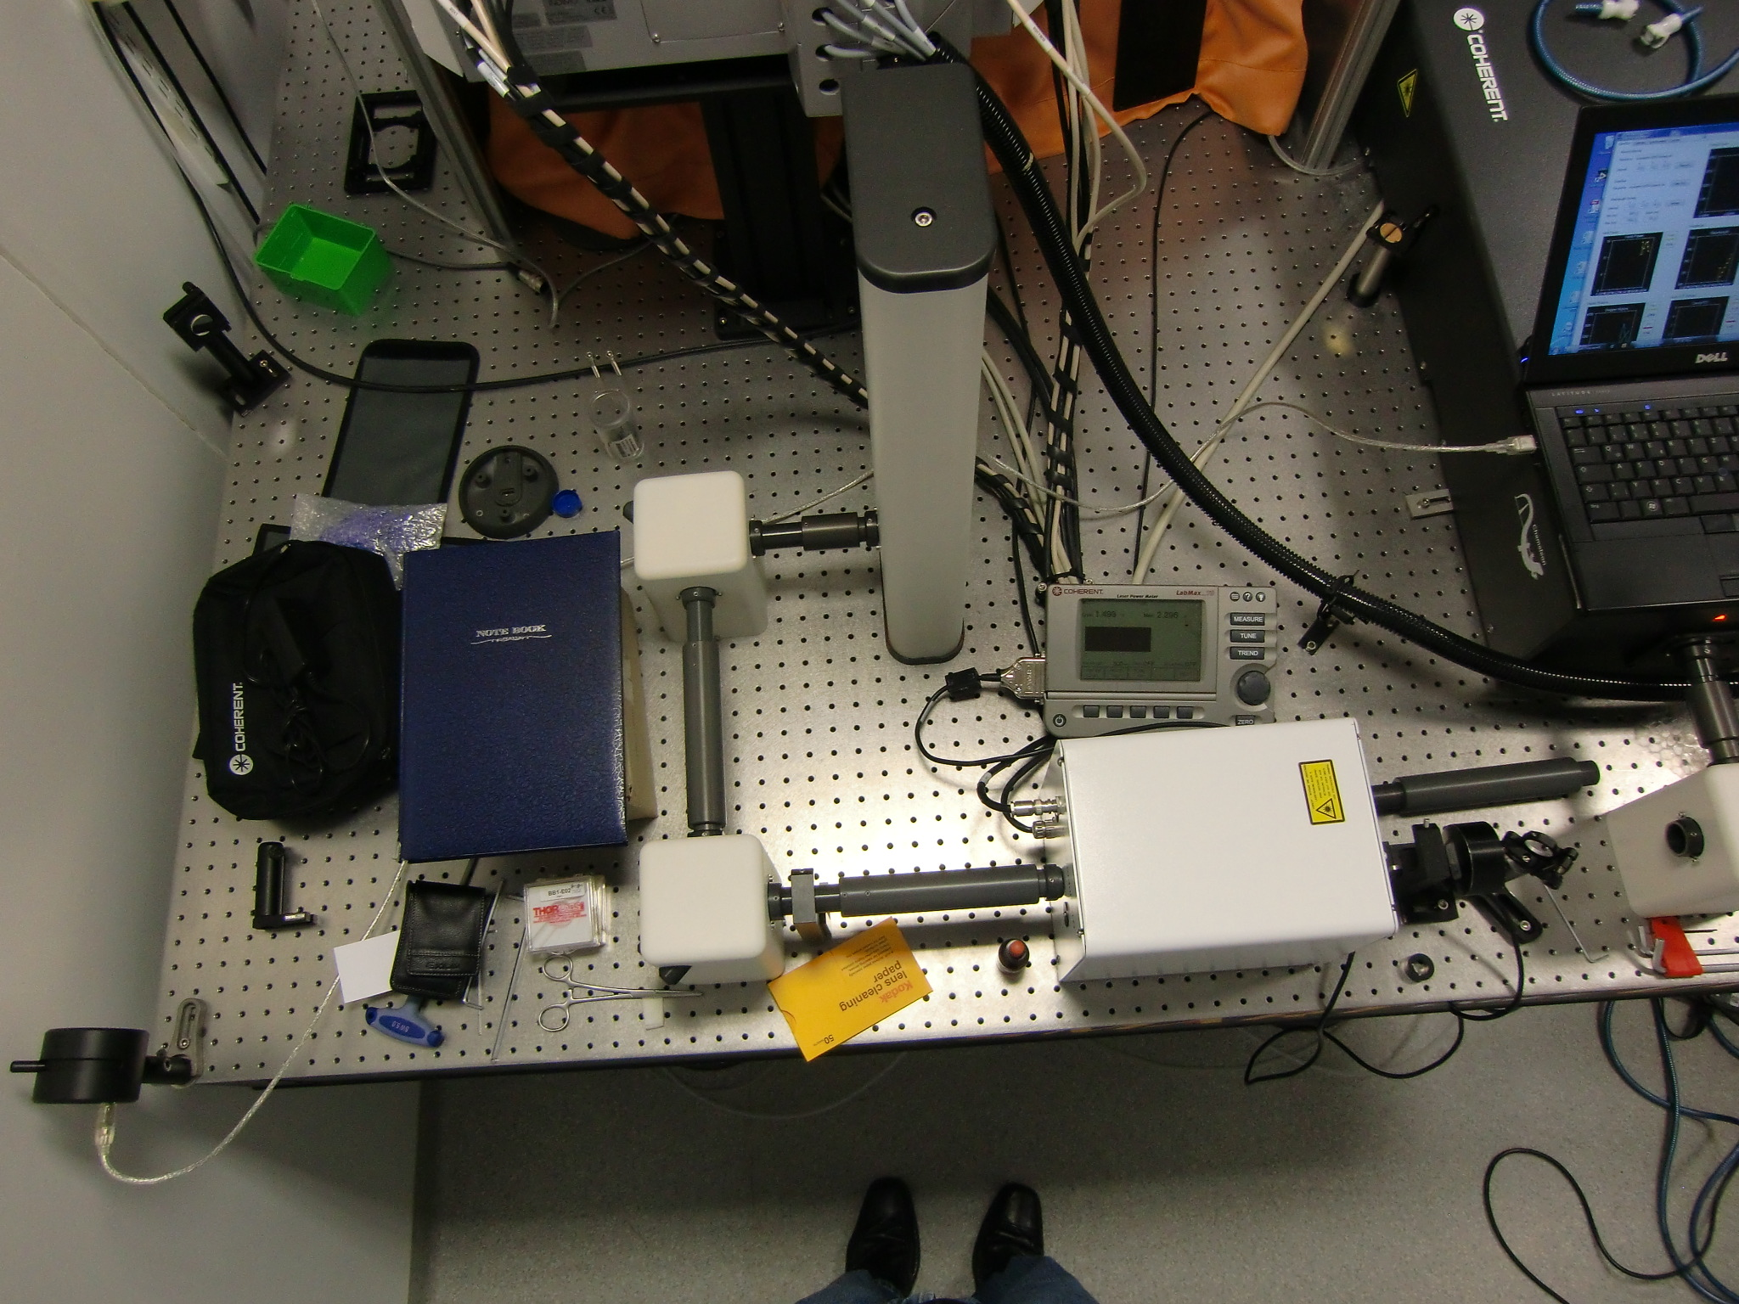
Pointing Measurement: Setup
Table Setup 1

Slide 7
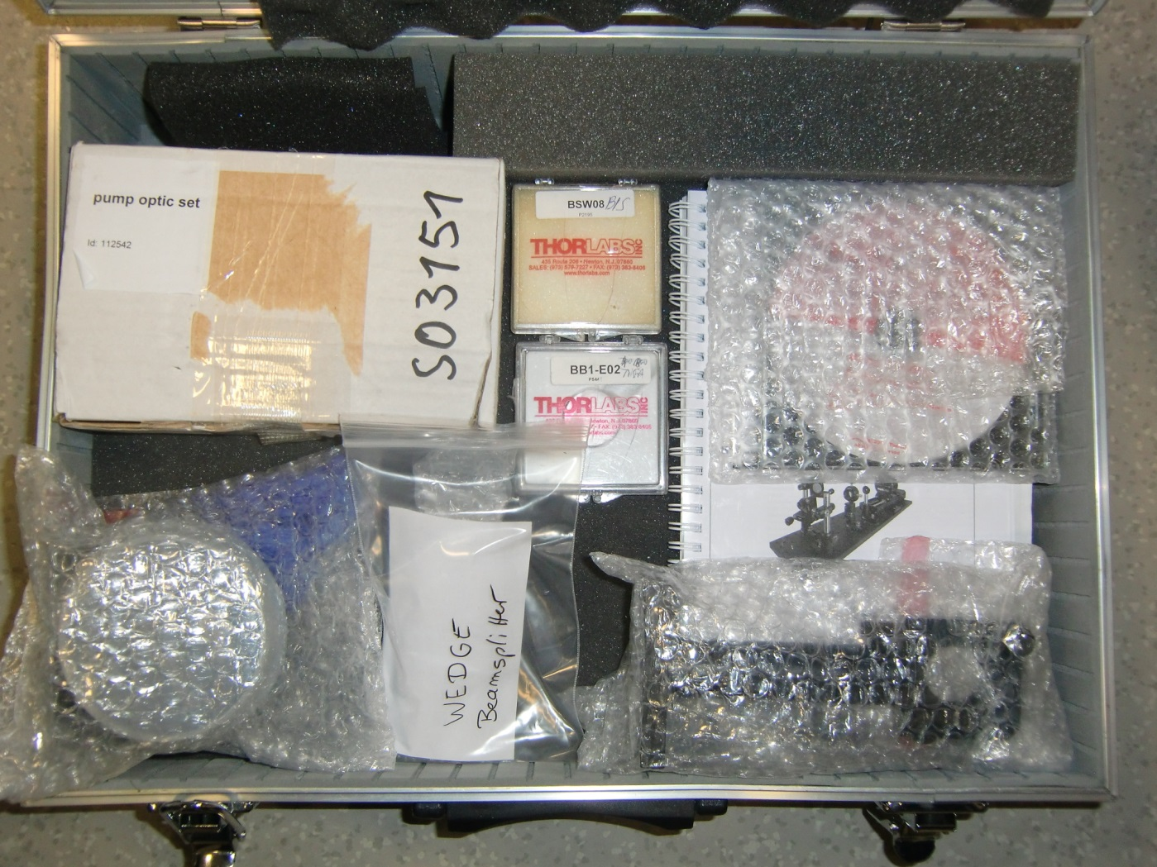
Pointing Measurement: Setup
Tool Box contain:
Manual and Software CDs
3 Mirror Holder
Thorlabs Detektor
(USB based)
2 HR Optic & 1 Wedged BS

Slide 8
Actual Measurement Recommendation
Measurement:
Put Beam into center of detector
Start i.e. with 680, or 700nm.
Tune 100nm in steps up to maximum
Measure the shift of each step
With a Vision, it would also make sense to check on different GDD values

Slide 9
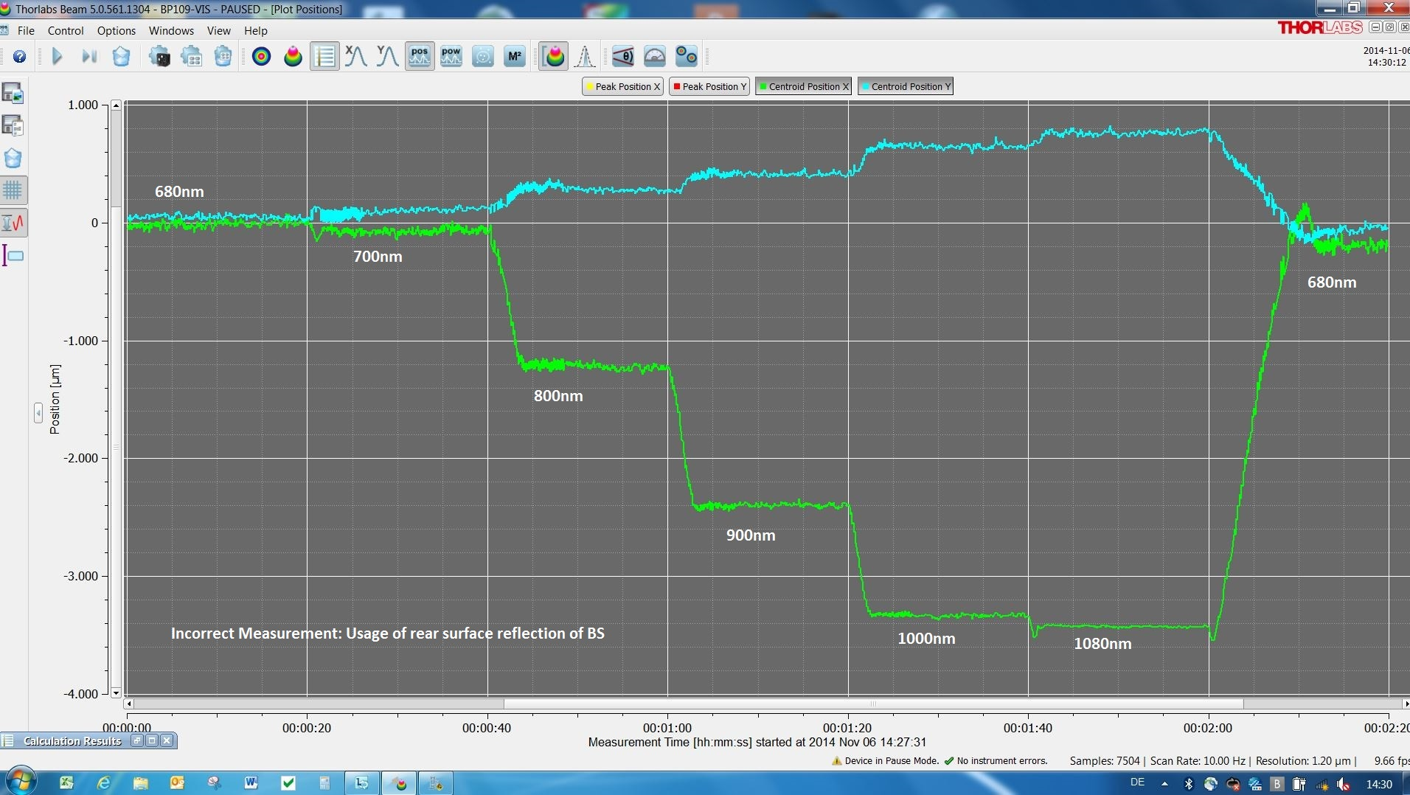
Pointing Measurement Result

Slide 10
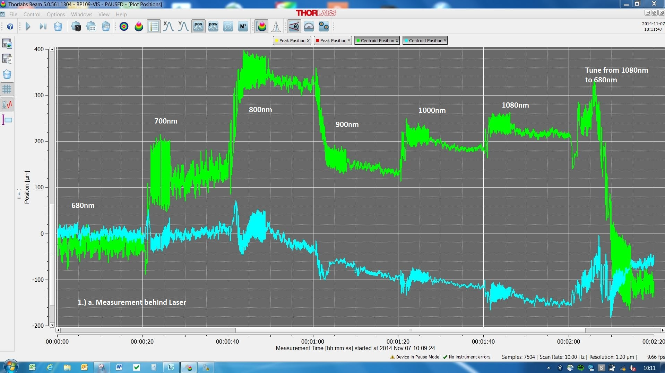
Pointing Measurement Result

Slide 11
Pointing Measurement: Calculation of Pointing Angle
Results:
Calculate the deviation angle (also called “Pointing”)
tan(alpha) = opposite leg / adjacent leg
Having very small angles, you can neglect calculating “tan”➔
Pointing angle alpha [µrad] = Detector value [µm] / Length between Laser and Detector [m]
Compare with specification
The interpretation of the released Pointing specification of Glasgow colleagues is like this:
Pointing deviation from lowest to highest wavelength point.
Spec is: <320µrad/400nm

Slide 12
Pointing Measurement: Longterm Drift
Laser Beam drifts away from Target in time (hours/weeks):
Drift in Time is not specified
Installed Long-Term Setup @ Uni Greifswald
PowerMax Software on Internet accessable PC
Bomgar Remote Session for picking measurement results
All Eye Safe: Fully Tubed
Zeiss Service needs to be present during installation & de-installation

Slide 13
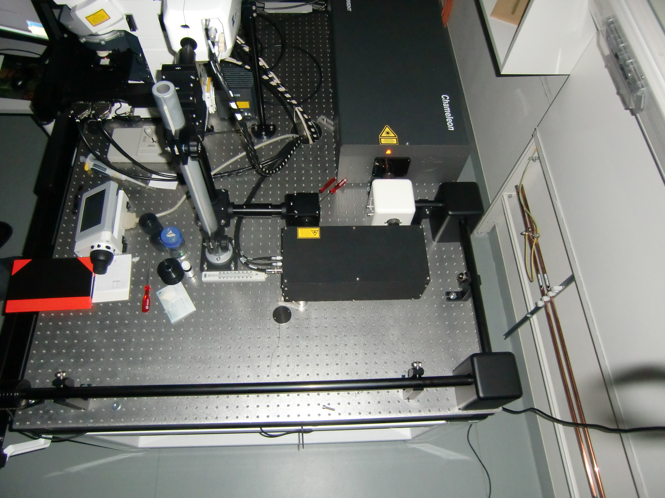
Pointing Measurement: Longterm Drift
Intensity Control
USB PowerMax Thermopile

Slide 14
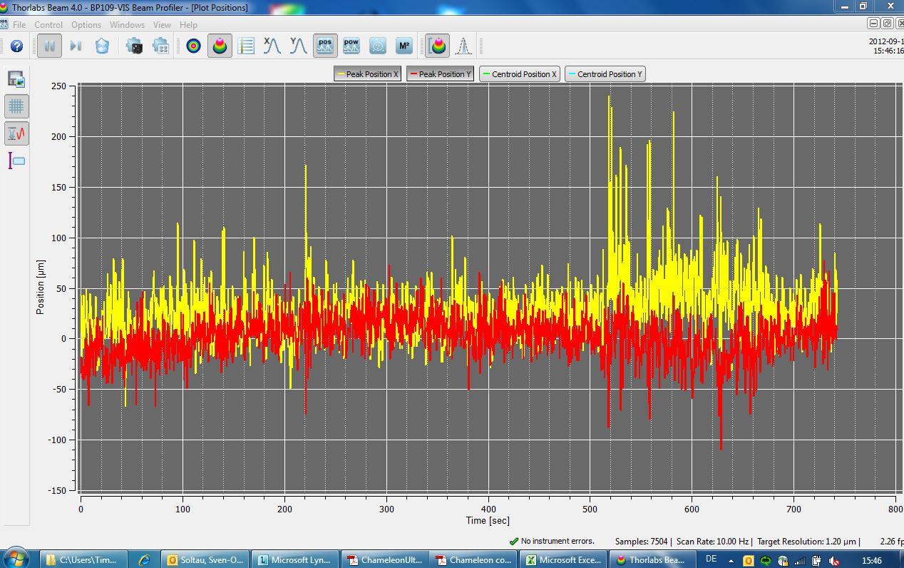
Pointing Measurement: Signal to Noise
Thorlabs Detector Noise is can be 100µm average.

Slide 15
Discussion: Published Specification, Part 2
Consideration of only two points:
λ(min) against λ(max) < 320µrad/400nm
Irritating Spec-Sheet description.
Pointing behavior in-between the two points is not considered.
1 Beamdiameter (1,2mm) shift in 3,8m distance is still in spec!
No Long-Term Drift specified
Our released specification does not meet requirements of Zeiss microscope application – Discussion ongoing.

Slide 16


Slide 17
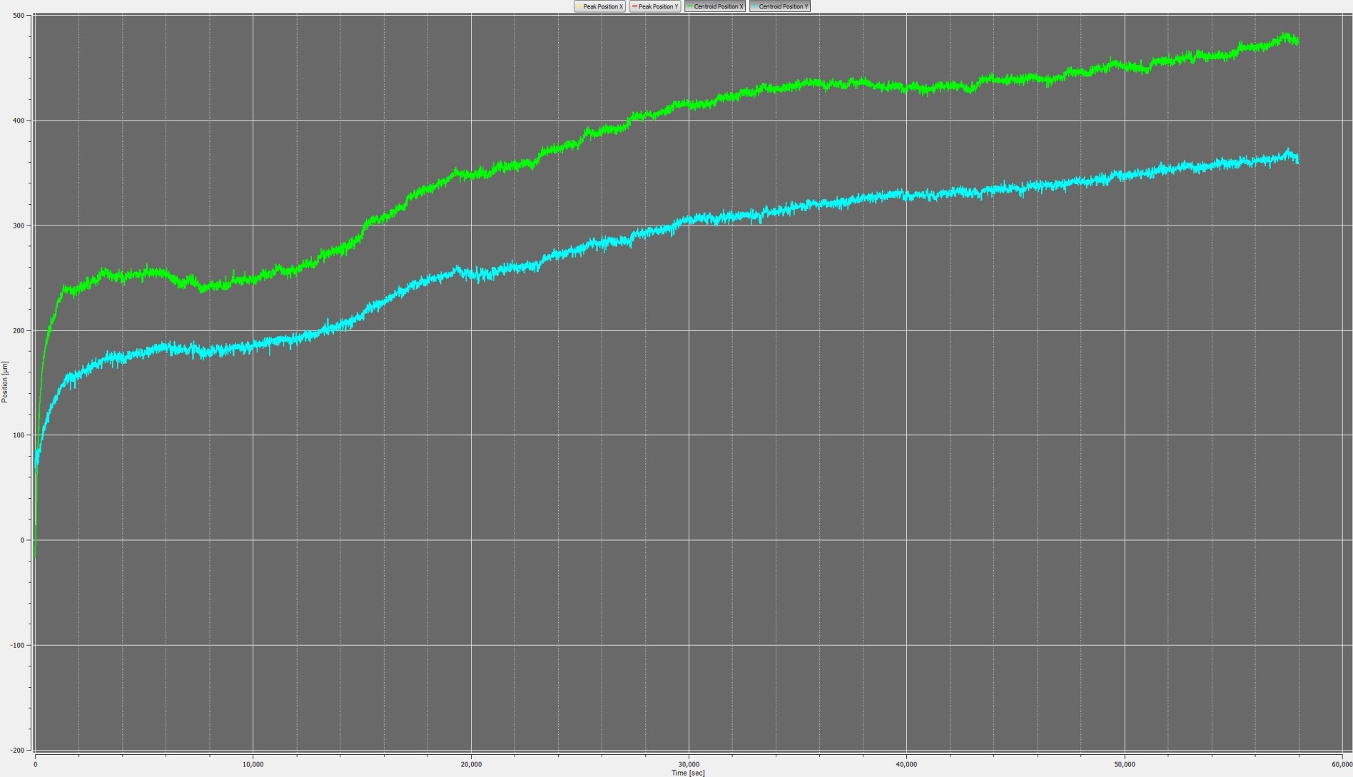
Long-Term Drift Measurement

Slide 18
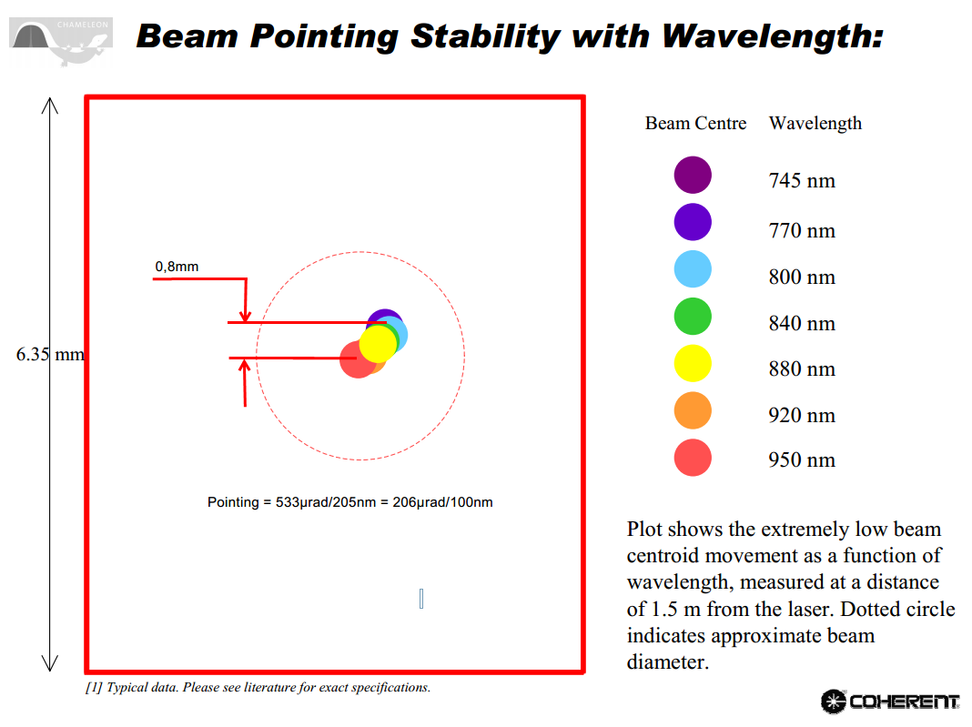
Old Pointing Data Chameleon XR

Slide 19
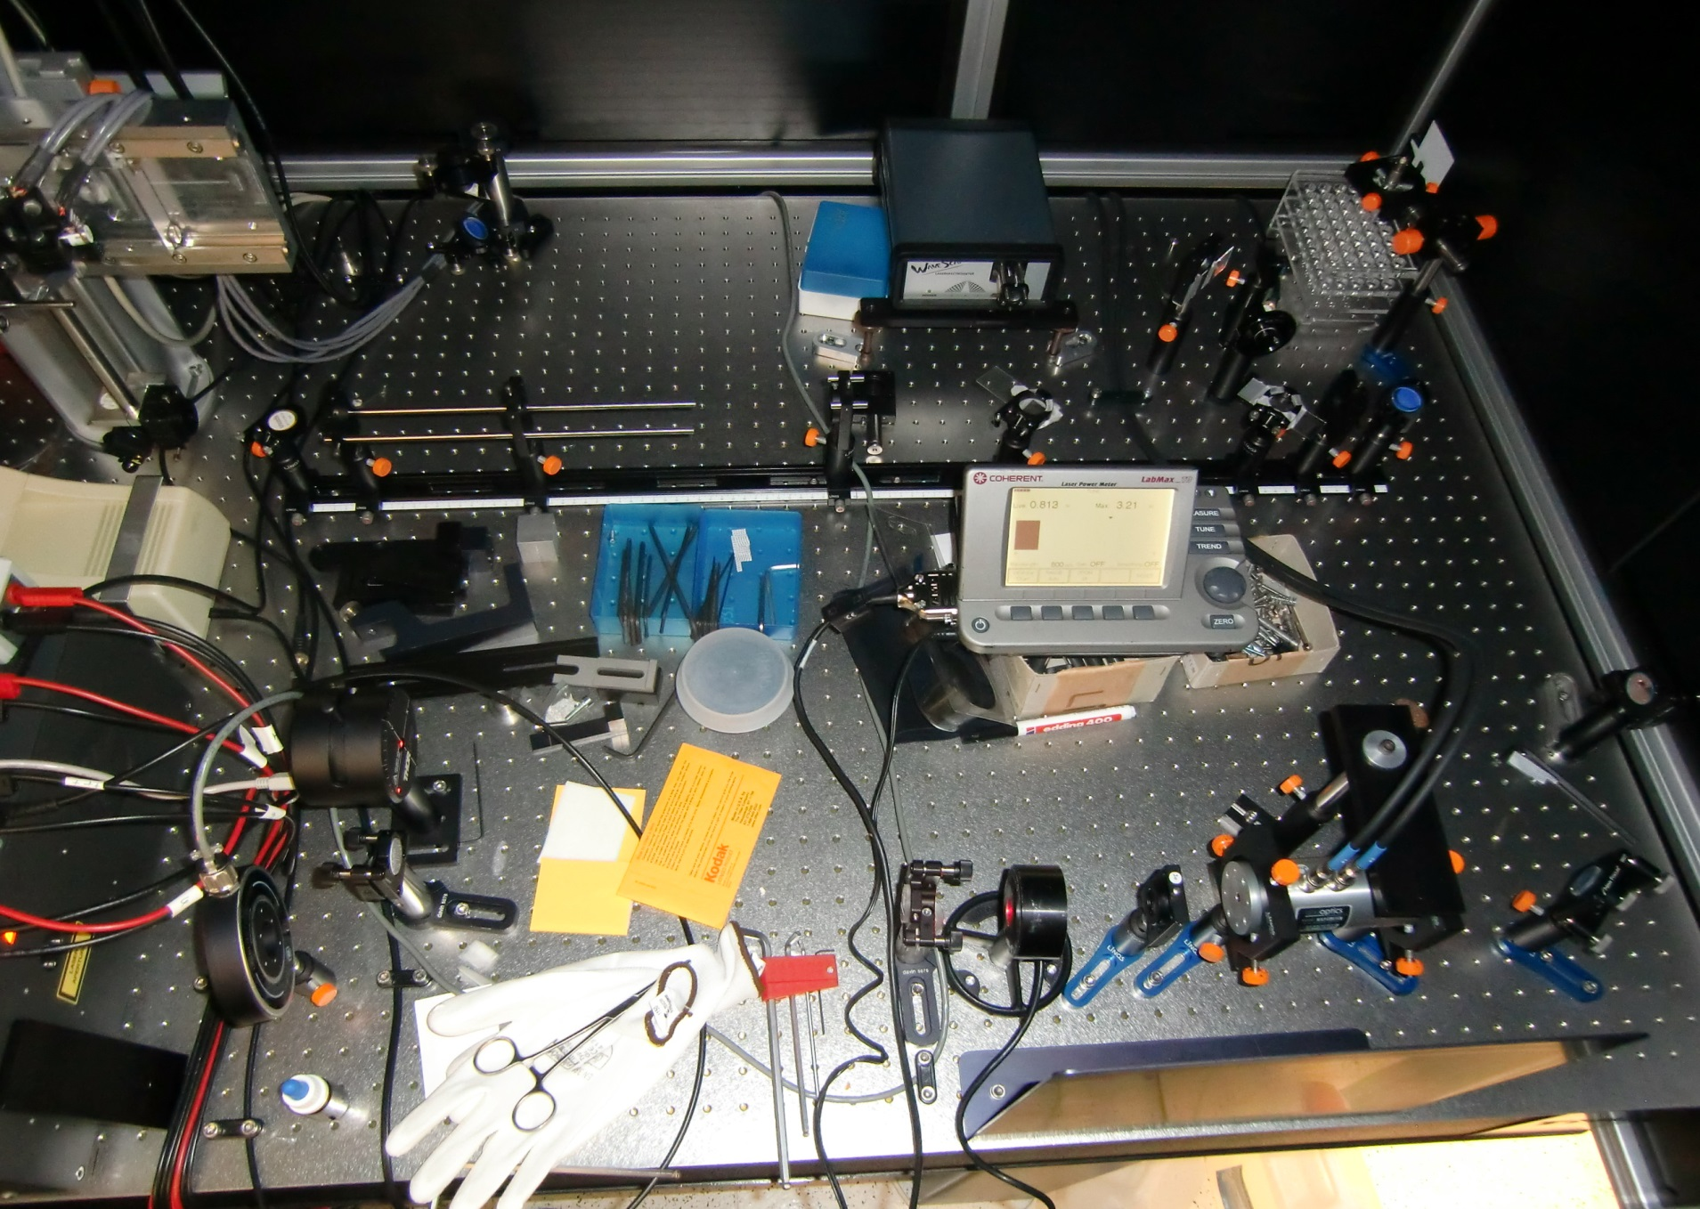
Drift caused by external Optics:

